Slide 1
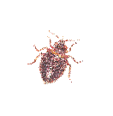
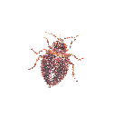
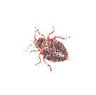
Integrated Pest Management in Multifamily Housing
The Northeastern IPM Center receives support from the U.S. Department of Housing and Urban Development's Office of Healthy Homes and Lead Hazard Control through USDA-NIFA to facilitate this program.
Notes:
1
Rev. 7/2014 Ver. 7/2014
The notes associated with the slides are for trainers to reference. Text in regular font supplements the information present on the slide. Text in italics gives extra information to be shared with or activities to be done with trainees.
Display this slide while trainees arrive.
During registration each trainee should
1. sign in legibly (so that the name can be put on a course certificate);
2. fill out a name tag for his/her shirt;
3. get a binder and pen; and
4. socialize.
Optional: trainees may complete an IPM Exam as a pre-test. For any that do, write "Pre-training" on the exam.
Determine who is in the audience (names, jobs, and skills).
Stay at the registration table and introduce yourself as people arrive.
Better yet, get a non-trainer to monitor the registration table so that you can mingle.

Slide 2








Developed and sponsored by
Notes:
Logos on this slide represent entities that have supported the training which was developed by the Northeastern IPM Center under a contract with USDA-NIFA. USDA-NIFA and HUD have an interagency agreement to provide this training to affordable housing (public housing and Project-based Rental Assistance properties) across the country.
This training was developed from courses piloted by
Rivard’s Resources: IPM;
Boston University;
Boston Housing Authority; and
The National Center for Healthy Housing.
A complete list of reviewers is in the Agenda section of the training binder.
Disclaimer: This IPM training program was developed by a partnership including the U.S. Department of Agriculture National Institute of Food and Agriculture, the U.S. Department of Housing and Urban Development, the U.S. Environmental Protection Agency, Centers for Disease Control and Prevention, The Pennsylvania IPM Program, the National Pest Management Association, the National Center for Healthy Housing, and the Regional IPM Centers. EPA, HUD, CDC, and USDA-NIFA provided funding.
The materials contained herein present a research-based, balanced, and objective approach to pest management in affordable housing and are intended to be used in their entirety. Any nonobjective or partial use of the materials is not recommended. Products, vendors, or commercial services mentioned or pictured in the trainings or presentations are for illustrative purposes only and are not meant to be endorsements.

Slide 3
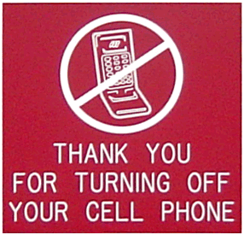
It’s Your Course!
Take care of yourself
Ask questions as we go
One conversation at a time
Notes:
3
Take care of yourself: If you need to use the rest room or stand & stretch, please do so.
Ask questions as we go
One conversation at a time
Be responsible for your learning (HEARING, seating)
Ask that cell phones be turned off or silenced.
Give directions for restrooms and asking questions.

Slide 4
Resources
The materials are yours to keep
  Copies of presentation slides
  Pest fact sheets
Workplan (our plan at end of each module)
Networked resources are available at:
  www.StopPests.org
Notes:
Give a quick overview of the agenda and materials
After trainees get an idea of what they will learn, explain that getting their questions answered is a large part of what we want to do. Encourage trainees to ask questions.
Suggestion: If a question is asked that will be addressed later in the day, write it on a flip chart (“bin” or “parking lot”) at the head of the classroom so that it is not forgotten.

Slide 5
By the end of today, you will know…
Why pests are health threats
How to control cockroaches, rodents, and bed bugs
Why Integrated Pest Management (IPM) is the most effective way to control pests
Your role in the IPM team
Notes:
This slide lists the course goals.
Housing management has committed to support an IPM approach and these are the things trainees will need to know to practice IPM. This course is not designed to license anyone to apply pesticides.

Slide 6
What position do you have on the IPM team?
Please tell us:
  Your name
  Your Job title or role
  Your greatest pest concern
Notes:
Have trainees introduce themselves and give their position.
Don’t let this turn into a complaint session, but if there are major concerns or problems at the property, they may be voiced at this time.
Suggestion: Have a flip chart up front where points can be written and addressed throughout the day. Do not answer questions at this time. This exercise not only gives the trainers an idea of the misconceptions, knowledge level, and experience of the trainees; it gives trainees ownership of the information presented throughout the day. At the end of each presentation, trainers go back to the poster paper and cross off the questions/topics that were addressed.

Slide 7
Pests cause problems
Trigger/cause asthma and allergies
Bite
Contaminate food
Lead people to overreact and ignore pesticide labels
Transmit disease
Hitchhike in belongings
Violate housing codes
IPM makes homes healthier!
Notes:
7
Mice drip urine and leave their dander wherever they go. Cockroaches leave their poop (frass) and shed skins. All of these in a home trigger asthma attacks and may even cause asthma.
Define pesticides as any substance or mixture of substances intended for preventing, destroying, repelling, or mitigating any pest (EPA). The chemicals that people use to kill pests pose a risk. Children are more vulnerable than adults because they are closer to the floor, do not have high tolerance for toxins, and put many things in their mouths. Pregnant women also are more vulnerable to pesticides. In addition, when exposed to pesticides, people with chemical sensitivities experience adverse reactions and will not be able to participate in daily activities.
If pesticides are necessary, residents and staff should leave their application to the professional. By using them, they could unnecessarily expose themselves and their families to pesticides and make the pest problem worse.

Slide 8
Priority Pests
Cockroaches cause asthma in infants, trigger asthma attacks, and contaminate food
Rodents such as mice and rats carry diseases, bite, destroy property, may cause fires, and may trigger asthma attacks
Bed Bugs and their bites are a nuisance and are expensive to eliminate
Notes:
8
These are the top three pests in affordable housing.
There are many pests that we could address in the course. Pest Management Professionals (PMPs) take much longer courses to understand each of the pests and that is why they are needed in any pest management effort. Encourage trainees to ask their PMPs questions. If qualified, they should know all the answers or be willing to get them.
Bed bugs are not the same thing as dust mites. This is a common misunderstanding.
Suggestion: Ask what pests are a problem at the property. Make a list of pests that are not cockroaches, rodents, or bed bugs. Try to incorporate the other pests into discussions throughout the day, noting when a control measure being discussed will help control other pests of concern.
Reference: The “______ are health hazards” slide in each of the cockroach, rodent, and bed bug presentations.

Slide 9
Other public health pests
Mosquitoes transmit West Nile Virus
  Need standing water
Ticks transmit Lyme Disease
  Get on people from bushes and rodents
Fleas cause itchy welts
  Come into buildings on pets and wild animals
Bird and rodent mites make us itch
  May move into a unit when the wild host moves out
Lice make us itch
  Spread on used or shared items and via person-to-person contact
Dust mites cause asthma
  Flourish with high humidity and poor sanitation
Notes:
These are the major public health pests identified by CDC. Each will be managed in part by the IPM approaches being taught for cockroaches, rodents, and bed bugs.
Use the public health pests to talk about how IPM for cockroaches, rodents, and bed bugs will solve other pest problems too.
Drying up pools of water so that rats don’t have a water source eliminates mosquito breeding areas.
Trimming shrubs and grass for rodent control helps with ticks.
Fixing holes prevents feral cats from entering buildings (a source of fleas).
Avoid bringing home used items because they may be infested with bed bugs. This practice will also help prevent lice and mites.
Dust mites are not bed bugs. Bed bugs will be covered later in the day. Used together: vacuuming, cleaning, and reducing humidity below 50% will help control dust mites. Unlike the other pests we have discussed, dust mites can’t be eliminated.

Slide 10


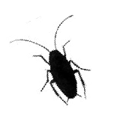
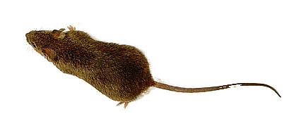
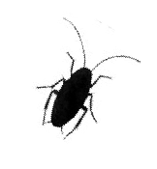


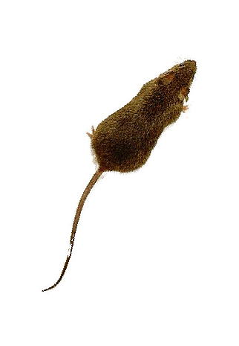
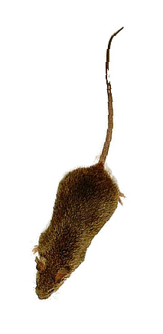
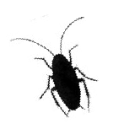
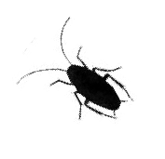
How have you fought pests?
Notes:
10
Give trainees time to describe what pests they see and how they currently deal with them.
Who is bugging you?

Slide 11
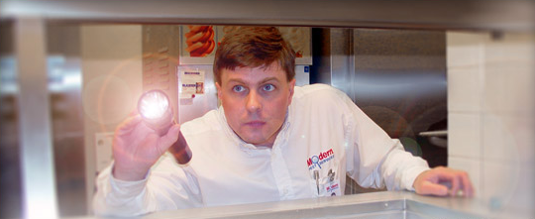
How will you fight pests now?
“Exterminator” is now a
Pest Management Professional (PMP)
Notes:
The discussion of how trainees manage pest problems and whether they have good control can lead into a discussion of “exterminating” versus “managing” pests.
Exterminating is an old term that the industry has moved away from.
It hasn’t been working for us. As the trainees may have experienced, treating with the intent to kill does not completely eliminate the problem. We are more likely exterminate ourselves in the process.
“Managing pests” is the correct expression and the one that will be used today. To manage pests, one must not only get rid of the current problem, constant preventative measures must be taken. Pest management is done with the help of a pest management professional, a PMP. “With the help of” is key. It takes everyone to manage pests.
Ask trainees if they think that their way is the best way to get rid of pests. Why or why not? Have a discussion. EPA does not assess effectiveness, only risk/benefit when used in accordance with the label. Try to incorporate effectiveness into the discussion. By the end of the day we want trainees to be able to choose pest control products based on risk AND effectiveness.

Slide 12
What is IPM?
Integrated: Uses multiple approaches that work together
Pest: What the multiple approaches work to fight
Management: Use of the most economical means with the least possible risk to people, property, and the environment
Notes:
12
Integrated: sanitation, exclusion, and baits.
Pest: cockroaches
Management: no more cockroaches!
Suggestion: Ask trainees what they think of when they hear “management.”
Tell them that they will have to be pest managers, overseeing all of the time and watching for parts of the building system that need to be fixed.

Slide 13
Inspect & Monitor
IPM
Program
Lifecycle
Evaluate Success
Identify
Use Multiple Tools
Scale
the Response

Slide 14
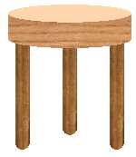
What all pests need
Food
Water
Shelter
Food
Water
Shelter
Notes:
14
Pests require three things to survive: food, water and shelter. Without any of the three, they won’t “stand up.” The three legged stool illustrates this point.

Slide 15
The IPM team
Property
Manager
Pest
Management
Professional
Resident
IPM
Coordinator
Landscaping
Services
Maintenance
crew
Resident
Support
Services
Procurement
Specialist
Janitorial/
Custodial
Notes:
Give a brief introduction to the IPM team approach. Note that housing management and HUD have agreed to support the use of IPM. IPM and roles and responsibilities will be further discussed throughout the day.
Explain how education and record keeping can be used to control pests. Education results in people in the housing community changing behaviors so that the property is inhospitable to pests. Record keeping brings accountability to pest management and ensures that problems are fixed before the infestation grows. Documentation and education will be in every aspect of pest management.
IPM Coordinator Makes sure all jobs are funded and completed. The property can’t outsource the responsibility for quality assurance of an IPM program.
Property Manager Responsible for the time and resource allocation at the property and often sets the tone for resident involvement.
Resident Support Services Gets assistance for residents.
Janitorial/Custodial Services Cleans common areas.
Building Superintendent Maintenance Crew Fixes moisture issues and makes repairs that block pests.
Resident Cleans regularly and prepares unit for inspection and necessary treatments.
Pest Management Professional (PMP) Conducts inspections and applies pesticides that pose the least risk to human health and the environment.
Landscape Services Chooses plants that are pest-resistant and grow with minimal chemical assistance. Minimizing rat habitat should be considered when planting.

Slide 16
What you will gain
Cost savings: Lower pest management costs over time
A healthier building: Fewer asthma attacks, less exposure to pesticides, and less of a chance you will take pests home
Fewer complaints: A Boston Housing Authority development reduced cockroach work orders by 68% after one year of IPM
Fewer pests: You can stop infestations from growing and spreading disease
Notes:
More effective than conventional pest management, IPM
helps prevent asthma attacks;
improves quality of life;
coordinates responsibilities;
relies on products and practices that work together and minimize exposure;
provides longer lasting control aimed at preventing pests;
makes better use of limited resources;
reduces complaints;
lowers pest control costs in the long run; and
Is more sustainable than relying on sprays alone.
100% elimination of the priority pests (cockroaches, rodents, and bed bugs) inside each unit is difficult, but can be done and should be the goal. With a team IPM effort, pest problems can be reduced to isolated incidents that get taken care of before they grow and spread. Asthma attacks and allergies can be triggered by any cockroach presence, so their presence should not be tolerated. It is possible to rid a unit of pests and clean up after them so that asthma attacks are reduced. For peer-reviewed research on these topics, visit http://www.stoppests.org/Research.
Suggestion: Remember, the audience is housing staff, not residents. Management needs to provide safe housing to its residents, but the fact that IPM repairs will make the workplace healthier for staff too may hit home for the trainees. Do any trainees know someone with asthma? Do trainees have family members or friends who are sensitive to or “allergic” to pesticides? Have trainees ever brought a pest home by mistake?
How would their jobs change if residents improved sanitation and there were fewer work orders? Note that work orders will increase at first since residents and staff will be encouraged to use the work order system, but when repairs have been made for prevention, there will be fewer work orders than ever.

Slide 17
“We do IPM because it is the right thing to do and because it works. Allowing our residents to live in a pest-free home is a basic service as well as a huge quality of life issue.”
––Gail Livingston
Director of Operations and Property Management
Boston Housing Authority

